Slide 1
COMPANY PREQUALIFICATION
USER GUIDE TO RENEWING REEGISTRATION, FILES AND SMS REVIEW v1.2

Slide 2
ACCESS & REGISTRATION

Slide 3
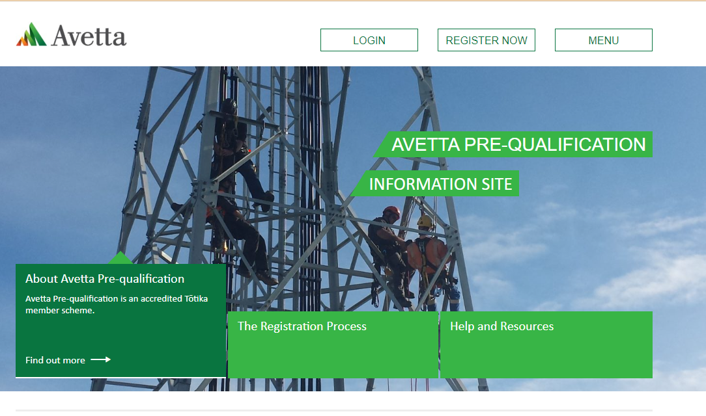
Visit Support Page
Dedicated webpage for all things Tōtika Company Pre-qualification related.
Details the Tōtika member scheme.
Contains step-by-step process. contact details and FAQ’s.
Head to the Tōtika page to learn more.
https://totikaprequal-avetta.co.nz/
When ready, click Register Now

Slide 4
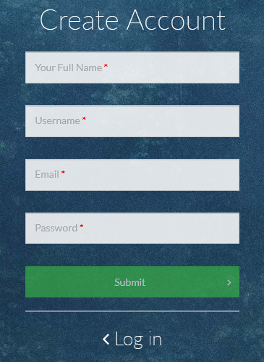
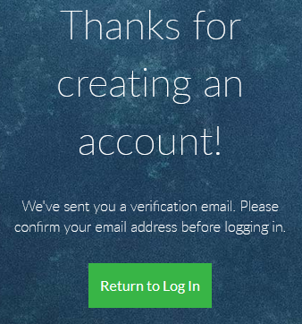
Registration
Login is required for future access
You will be sent an initial verification email that must be validated
Once competed, access will send a notification email to action
If you have previously registered, it will inform you. You will be prompted to use the password reset feature if you have forgotten your login.
Begin by creating a login for the Pre-qualification portal
Enter in your details
Press Submit when done

Slide 5
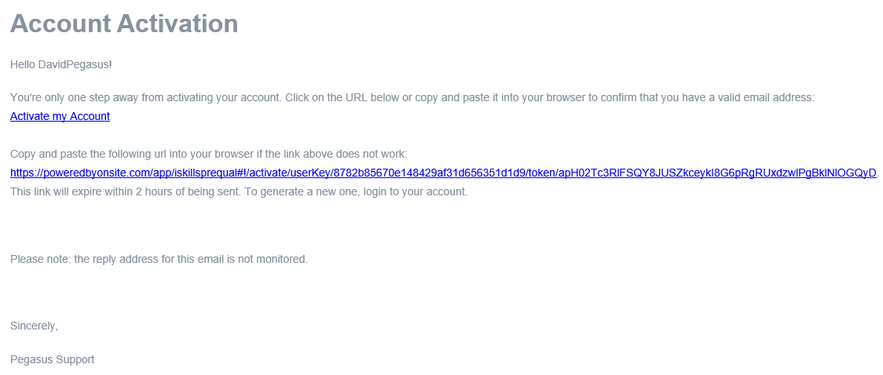
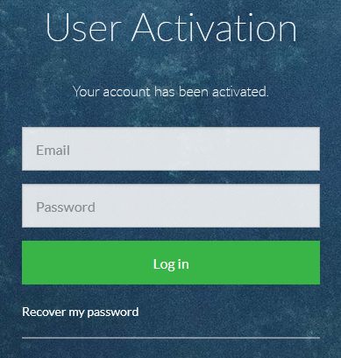
Registration Activation
Failure to register in the timeframe will require you to re-request a verification email.
References to Pegasus will appear on the email and the domain poweredbyonsite.com - these are valid Pegasus links.
Avetta acquired Pegasus in 2021.
Press Activate my Account within the time period, to continue.
Once activated you will be taken to the login screen, notifying you that your account has been activated.

Slide 6
SUPPORT
https://totikaprequal-avetta.co.nz/
Phone: 07 542 0857
totikaprequal@avetta.com

